Slide 1


Please visit our website at www.Health-For-Everyone.com

Slide 2
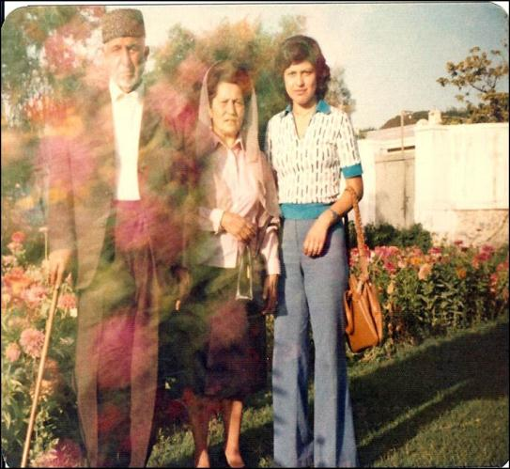
Dr. Sima’s family home before Russian invasion
Once upon a time, families lived in a country filled with gardens of flowers.

Slide 3
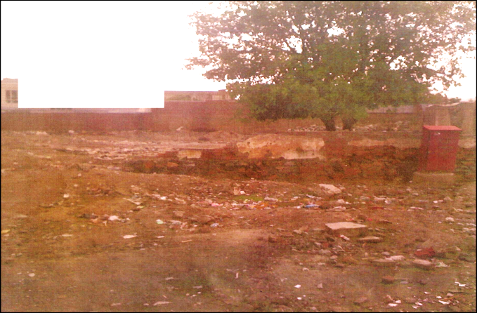
A peaceful and beautiful country destructed during the longest war in history.
Dr. Sima’s family home after the conflict

Slide 4
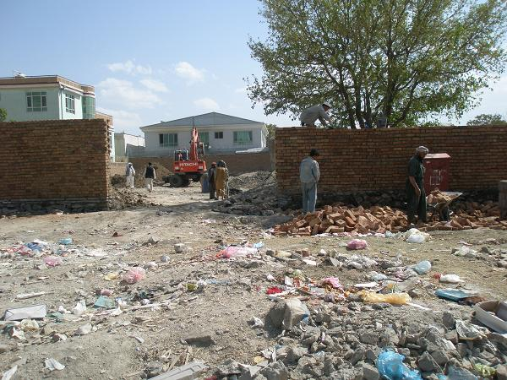
We will not give up and will restore our country

Slide 5
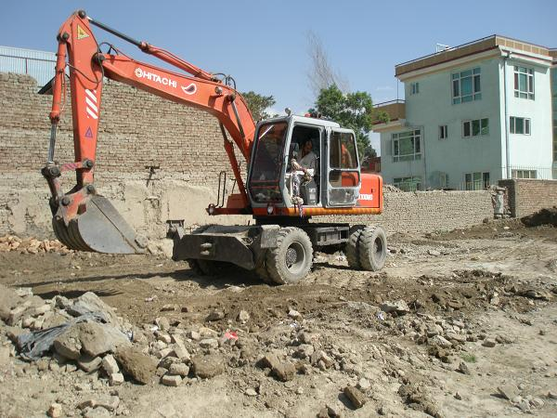
Clinic during construction

Slide 6
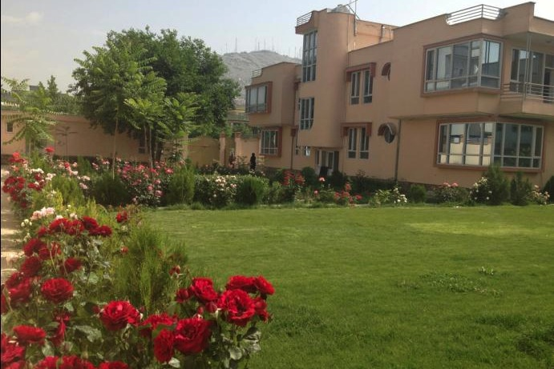
A medical clinic came out of the ashes of destruction

Slide 7
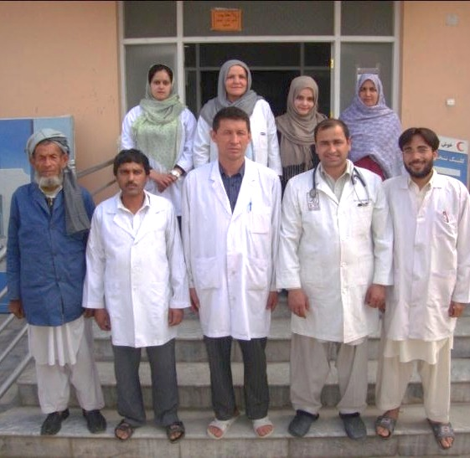
Meet our talented, caring doctors and staff

Slide 8
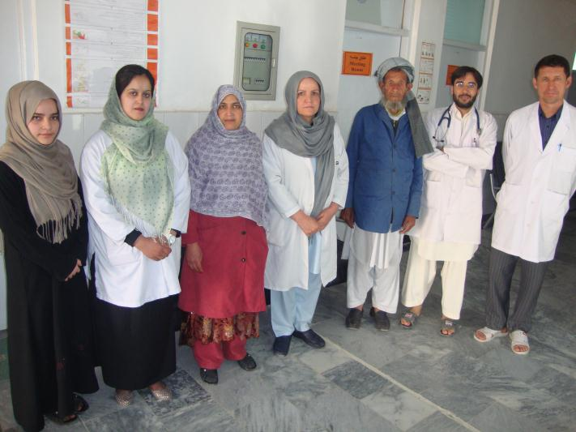
Free vaccinations and family planning are provided in the clinic

Slide 9
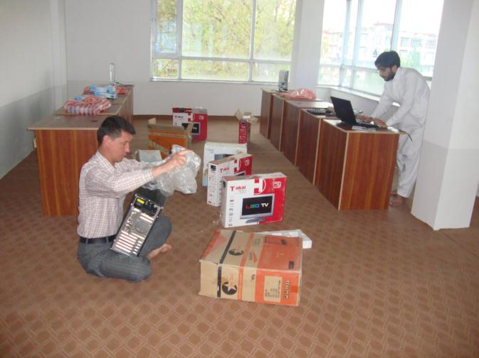
Four computers, 10 computer tables, and the floor carpet are donated by “Health For Everyone” at the beginning of May 2014.

Slide 10
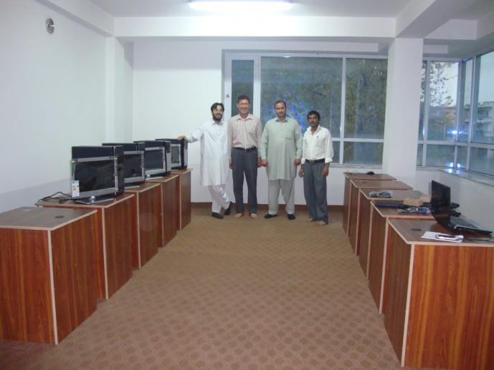
Our training and conference room is ready for medical and nursing students to be trained.

Slide 11
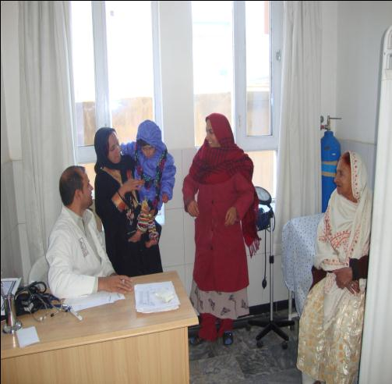
Dr. Asem while seeing patients at the Ghaussy Family Clinic

Slide 12
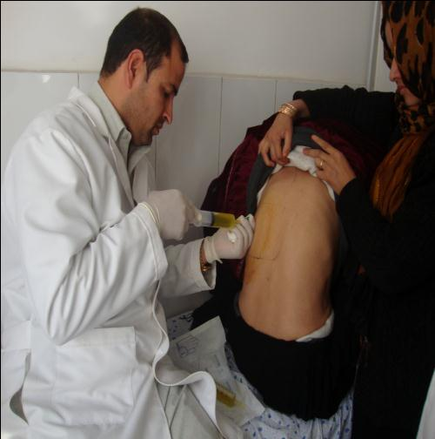
Patient with fluid in her lung and during a diagnostic procedure

Slide 13
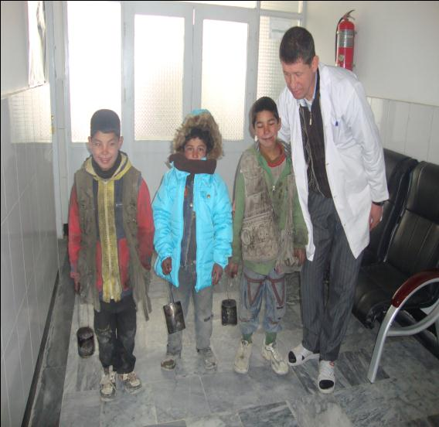
Mr. Khursand our RN helping patients in the clinic

Slide 14
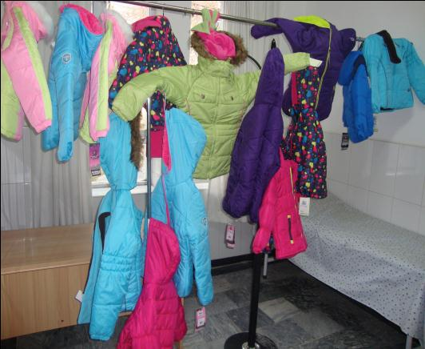
Generous donations from Afghan American Women Association from Washington D.C.

Slide 15
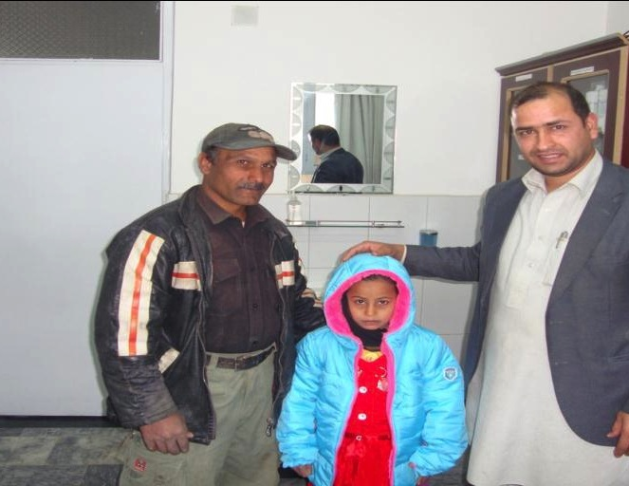
Children receiving donations at the clinic

Slide 16
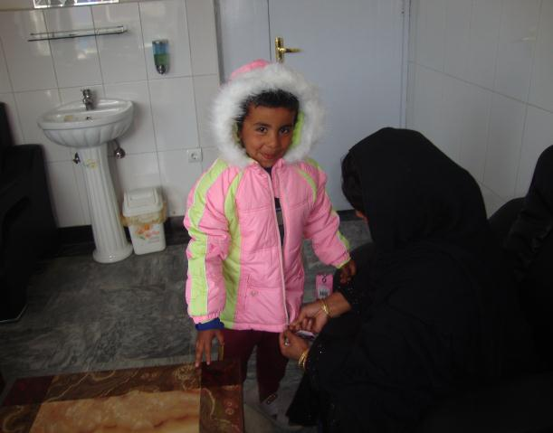
Children receiving donations at the clinic

Slide 17
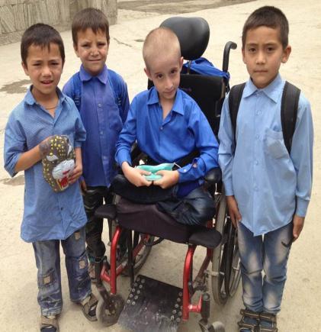
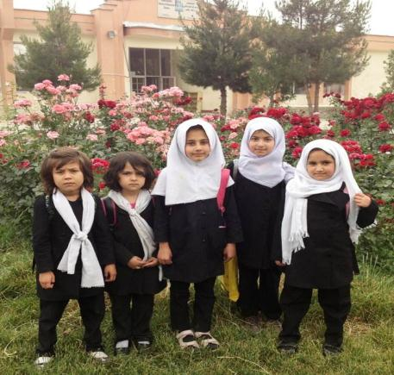
LET’S COME TOGETHER AND PROVIDE A HAPPIER AND HEALTHIER FUTURE FOR OUR CHILDREN OF AFGHANISTAN.

Slide 18
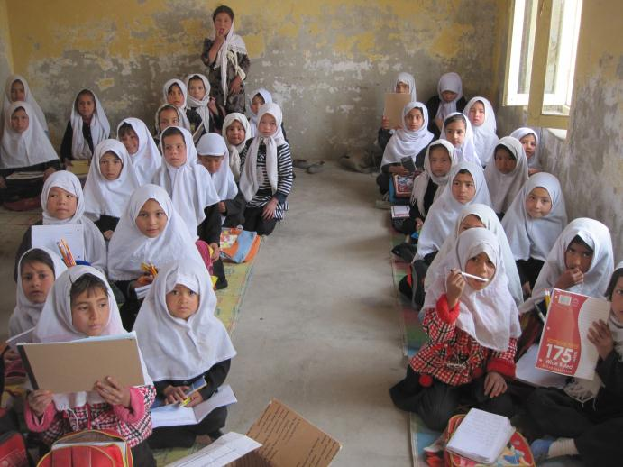
We will restore health and education for our future generations

Slide 19
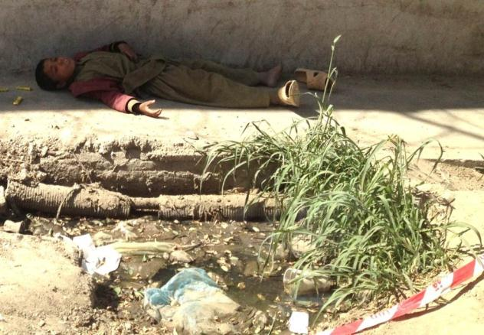
Let us provide a health care system to help the most unfortunate like this boy with seizures.

Slide 20
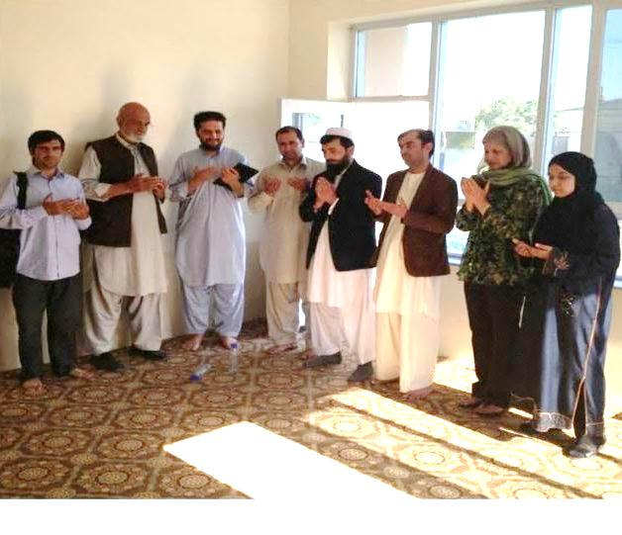
We will pray for continuous success for the clinic to help the needy people of Afghanistan

Slide 21


Health For Everyone was founded by Dr. Sima in March 2007
Health for Everyone is a non-profit organization
Health For Everyone is a registered 501c(3) non-profit organization with 100% of the donations used to build and run medical clinics. Please visit our website
www.Health-For-Everyone.com

Slide 22


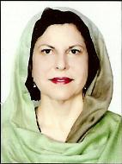
Donations are critically needed to staff, run, and support the clinic.
Visit our website:
www.Health-For-Everyone.com

Slide 23


Health For Everyone
Dr. Sima
How to Help
Make a one time donation
Make monthly donations
Purchase medical programs DVD
How to Make a Donation
Health For Everyone
Visit Heath-For-Everyone.com and donate using Paypal: sima-md@hotmail.com
Send your tax-deductible donation to:
To purchase medical programs on DVD send an
e-mail to:
sima-md@hotmail.com
3180 Willow Lane Suite 200
Westlake Village, CA 91361
Attn: Dr. Sima

Slide 24
THANK YOU!
For your generous donations and keep us in your Prayers

